Slide 1
M-V-C and Xibs

Slide 2
Design Patterns
A reusable software template for commonly occurring problems
Different classes of patterns with examples we will use in class
  Creational patterns define ways of constructing objects
    Examples: Protocols, Singleton pattern
  Structural patterns define relationships between classes
    Examples: Wrapper (or Adapter) pattern, Delegation
  Behavioral patterns specify communication between objects
    Examples: Chain-of-responsibility pattern
  Concurrency patterns deal with multi-threading
    Examples (maybe): Active Objects, Mutual Exclusion Locks
  Architectural patterns delineate roles or tasks (conceptually)
    Examples: Model-View-Controller

Slide 3
The MVC pattern
Model-View-Controller pattern (or MVC) separates data from the user interface (UI)
  This creates a more modular system
The 3 main components are…
  Model: manages data and behavior
  View: Manages the graphical/textual inputs and outputs with user
  Controller: communicates between Model and View
How does this work?
  User inputs a command into the View Controller handles the input and updates the model (sends new slider value to Model)
  The View updates based on changes to the Model (filter coefficients update)

Slide 4
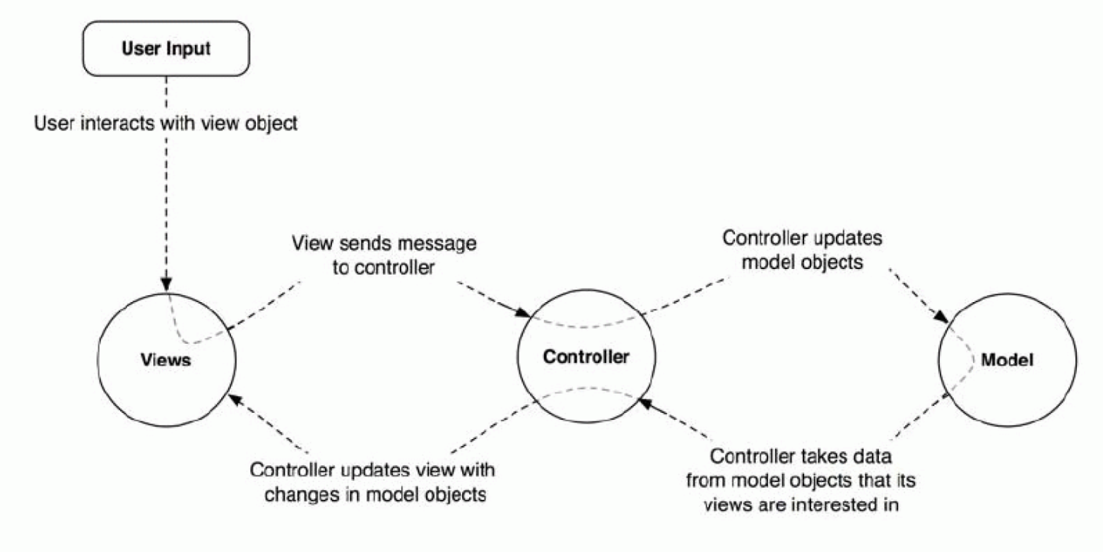
The MVC pattern

Slide 5
Example: The model
The Model ‘solves the problem’ or ‘does the work’, and is always independent of the Controller and View
  The Model provides the services for the Controller to pass along information and receive updates
Example: LPF (Bi-quad) coefficient calculator
  Method(s) to set the cutoff and Q
    This information is passed in by the Controller
  Notifies the Controller once new coefficients are computed

Slide 6
Example: The Controller
The Controller decides what needs to be done, and carries out the logical flow or progression of the App
  The Controller interfaces between the View and the Model
Example: LPF (Bi-quad) coefficient calculator
  The user changed the cutoff frequency (via the View);
  therefore, the Controller requests new coefficients from the model,
  and then updates the text labels (in the View) that display those coefficient values.

Slide 7

Example:
The View should represent a true state of the Model, but receives its information from the Controller
  The View is a passive observer of the Model
  View objects are visible to the user
Example: LPF (Bi-quad) coefficient calculator
  The View holds the slider, editable text boxes, and text labels (displaying coefficient values)
  The View has an ‘outlet’ to the Controller to call it when the Fc or Q are changed (by the user manipulating the slider or text boxes)
  The View can receive notifications from the Controller when the coefficients are updated

Slide 8
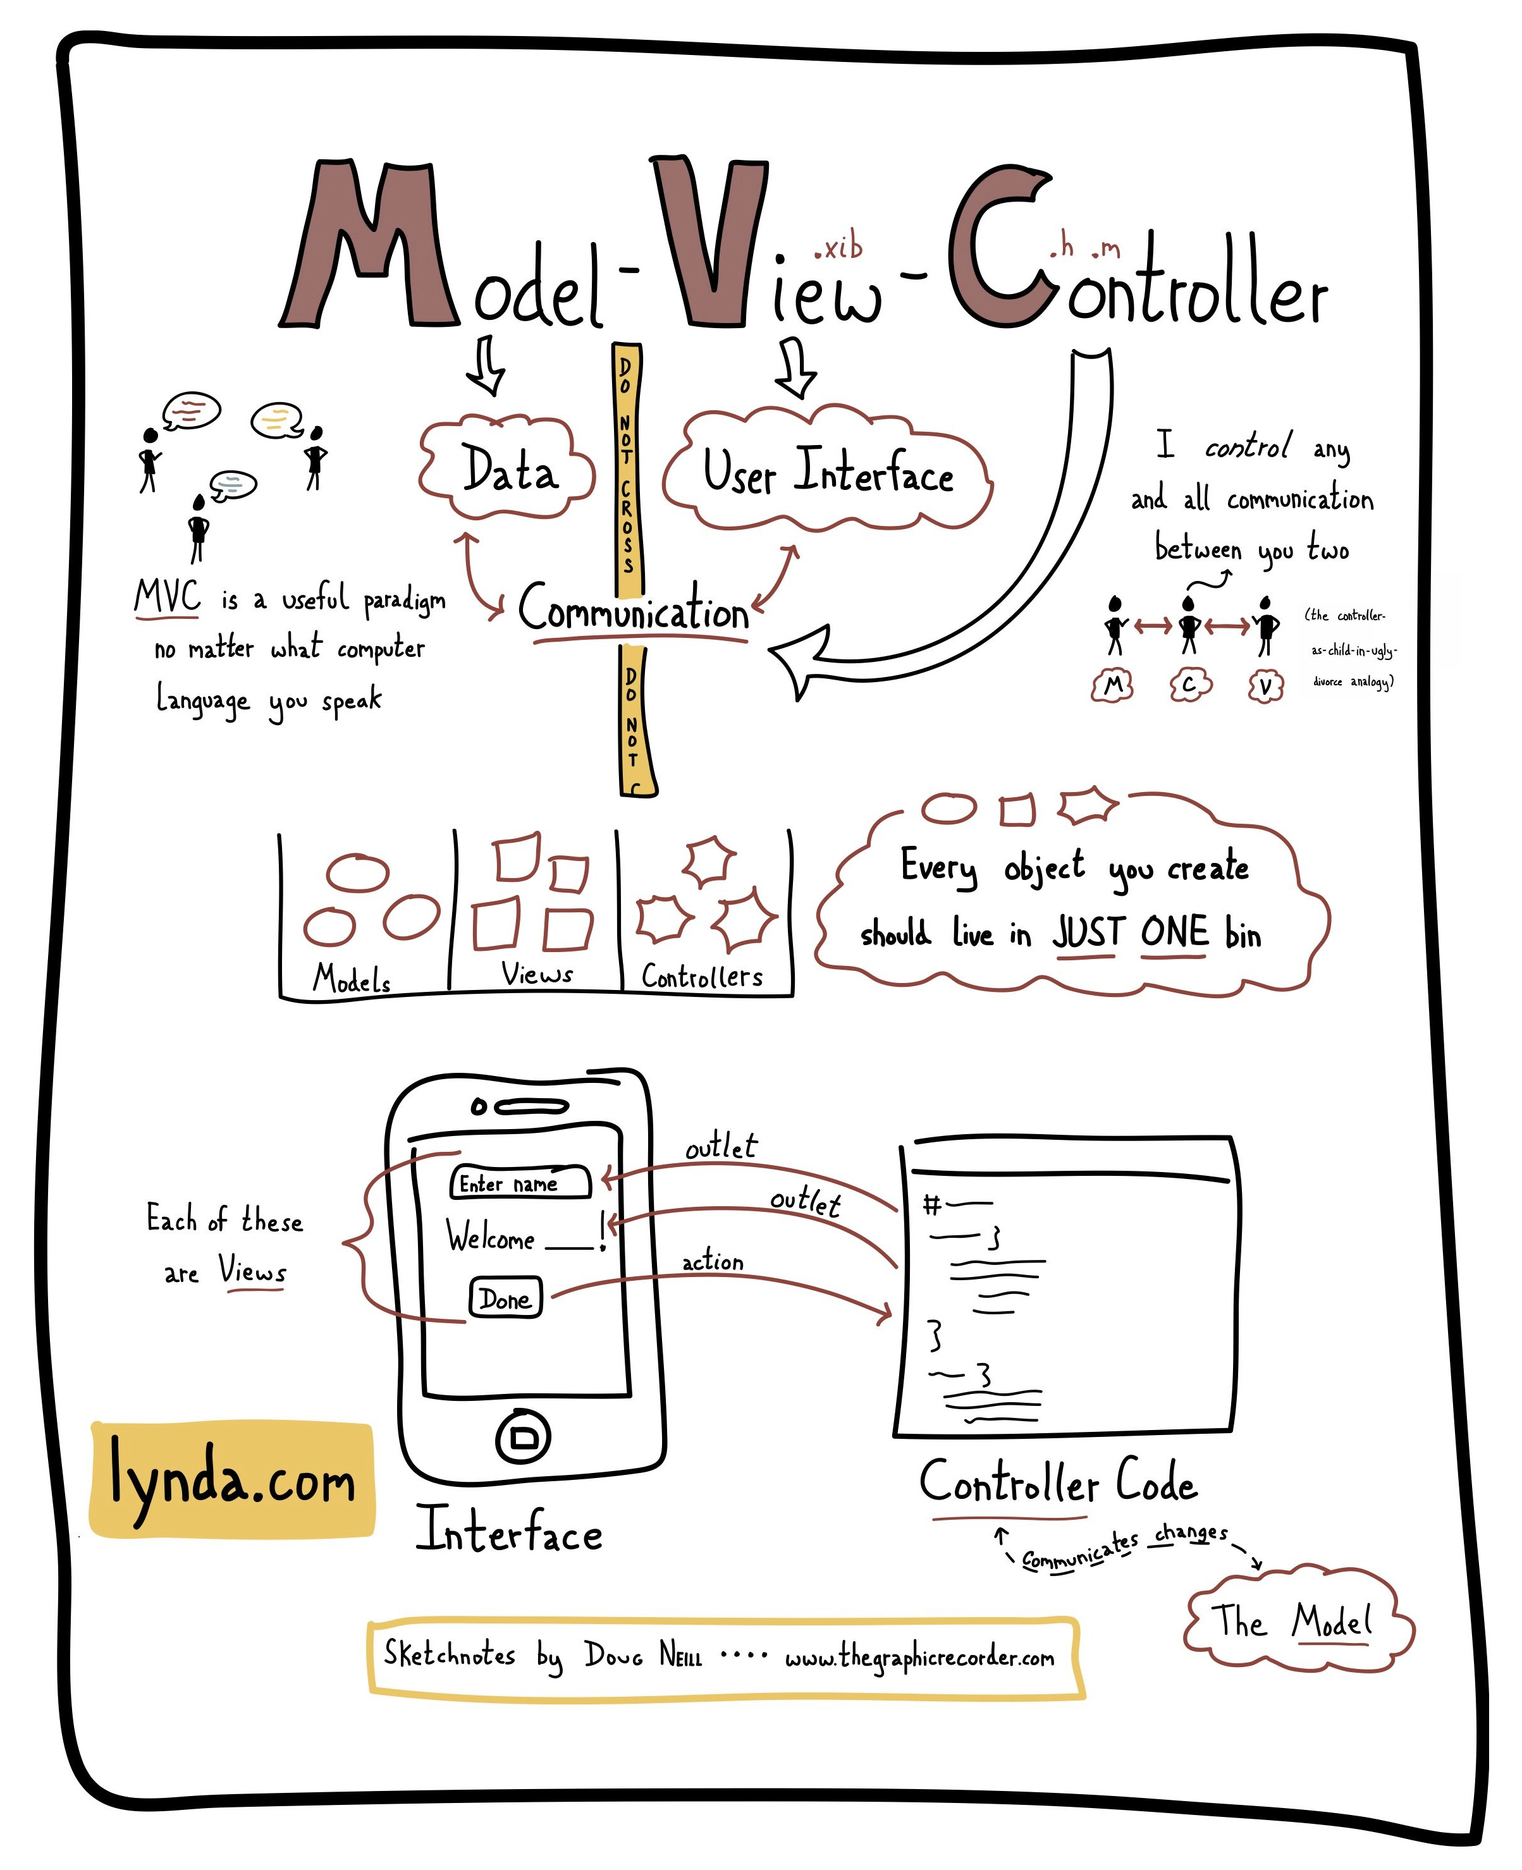

Slide 9
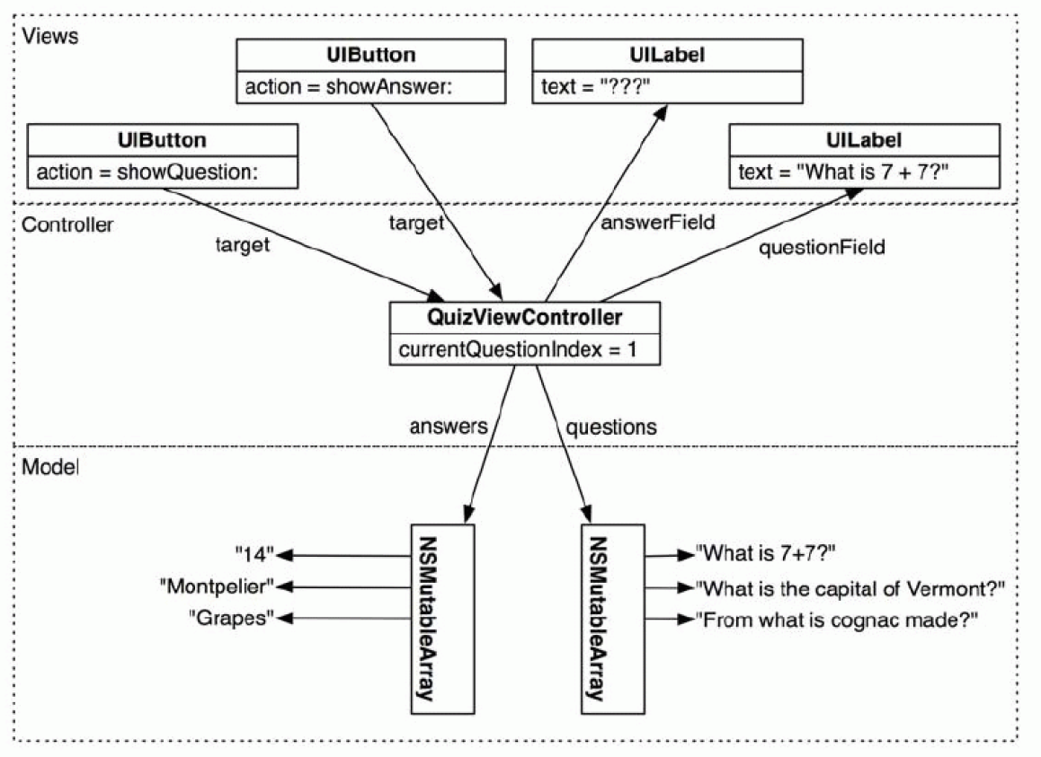

Slide 10
View objects
Types of objects
  Label, Button, Switch, Slider, Tables, Pickers, Gestures, … or custom
View Object properties
  Outlet: allows the Controller to manipulate properties of the View object
  Action: allows the Controller to be notified of changes performed by the user
General Object properties
  Nonatomic, weak: To be discussed in Chapter 3 (Memory management)

